Slide 1
LUISS ENLABS
“the startup factory”
February 2014

Slide 2
THE STARTUP FACTORY
startup accelerator founded in 2010, called LUISS ENLABS after the joint venture of 2012 with LUISS University;
called LUISS ENLABS after the joint venture of 2012 with LUISS University;
first Italian example in which entrepreneurial system, university and Venture Capital are linked together;
represents LVenture Group micro seed investments funnel.

Slide 3
LVENTURE GROUP
LVenture Group is a participation holding listed on Milan Stock Exchange;
operates on an international level
in the Venture Capital field;
makes investments in startup
operating in the digital world;
ensures high qualified skills
through an “hands-on” approach:
active management of investments.
Startup
accelerator
Venture
Capital
University

Slide 4
LUISS ENLABS ECOSYSTEM
Sponsor
BAs & VCs
Universities
Corporation
50+ Advisors
Partners
18 Startups

Slide 5
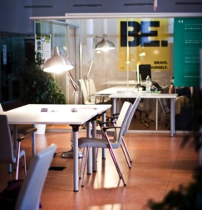
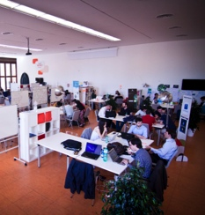
STARTUP FACTORY MODEL
Networking
Know How
Biz-dev
Increase
Success rate
Location
Facilities
Financial
Resources

Slide 6
ACCELERATION PROGRAM TIMELINE
Selected startups’ goal is to realize, by the end of the program, a useful running product / service for a first market test.
Activation
+
Retention
Acquisition
+
Referral
Revenue
2 months
2 months
1 month
Courses & Seminars
Lean startup foundations
Understanding investors
Lean business models
Startup metrics
Business planning
How to pitch an investor
Prove pitch

Slide 7
INVESTMENT FOCUS
sectors
key criteria
ICT
m/e-commerce
online media
gaming
web & mobile apps
disruptive technology
complete and heterogeneous team
international and growing market
strong competitive advantages
scalable business

Slide 8
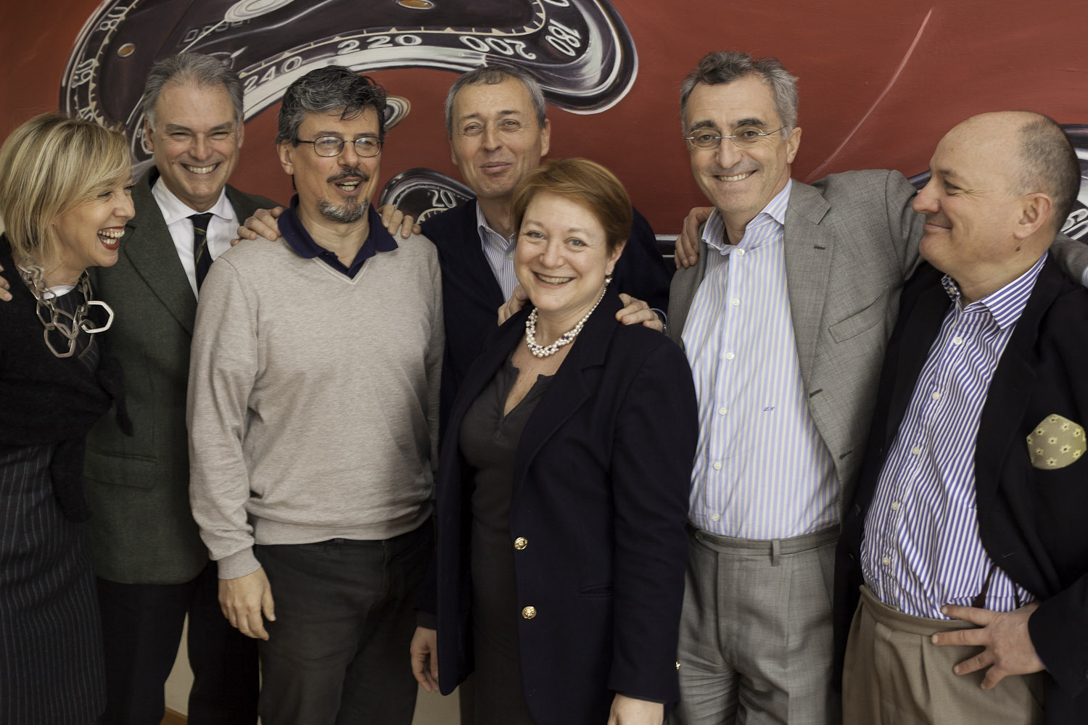
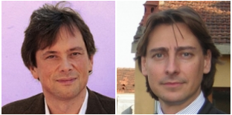
TEAM & ADVISORS
experienced team with combined skills
high reputation and strong networks
positive track record from sucessful experiences
+50 professional advisors

Slide 9
KEY SUCCESS FACTORS
Deal Flow
sourcing innovative tech startups from numerous and reliable funnels
Selection
consolidated evaluation models combining professional and entrepreneurial criteria
Added Value
active approach: intensive acceleration program, mentorship, advisory, business networking & developing
Success
focus on most promising deals with active role in achieving highest capital gain

Slide 10
PORTFOLIO

Slide 11
ACHIEVEMENTS
Ca. 2 mln € invested in 24 startups;
portfolio startups have raised more than 4 mln € from other investors;
reverse merge with a listed Company on Milan Stock Exchange;
LUISS ENLABS moved to the new spaces inside Termini railway station;
Do!Lab – digital smart learning – project launched.

Slide 12
Do!Lab PROJECT
WHAT:
a school to help people to learn the digital disciplines using a smart format and innovative methods, to give the professional abilities required by Information and Technology market.
WHY:
digital is everywhere, the job recruiting world needs technological skills: Do!Lab intends to give more chances and to build new plans for the future.
WHO AND WHERE:
Lventure group in partnership with Codemotion, in an innovative location as LUISS ENLABS, a space where entepreneurs and innovative startups are the main characters.
WHEN:
the school will start next 7th of February, with the first course of TechLab, focused on basic programming.

Slide 13
Do!Lab PROJECT
Participating to the economic, social and cultural growth.
Promoting enterpreneurship and sustain the growth of Italian innovative and sustainable startups.
Having a positive impact on the job market, working on training, orienting and riqualification of competitive professionals in Italy and abroad.

Slide 14
Do!Lab PROJECT
Social media strategy and management classes
Coding classes (4 courses)
Vertical modules
Do! Moments
Tutoring
Event
Final project
Stage in a company or startup
Web design classes

Slide 15
CONTACTS
More info @ luissenlabs.com / lventuregroup.com
Cristina Marchegiani, Comunication & Events Manager
cristina.marchegiani@luissenlabs.com

