Slide 1

The Capability Approach for
Poverty and Wealth Reporting:
Experience from Germany
Christian Arndt
(HfWU and IAW)
ISFOL-Conference, Rome, May, 23rd 2012

Slide 2
1 Motivation and Aims
Capability Approach (CA) as theoretical framework for
multidimensional and multivariate official Poverty and Wealth Reporting in Germany
Present and discuss
  the establishing of a offical reporting in Germany
  multidimensional theoretical concept and empirical operationalization
  latest developments of the official reporting in Germany

Slide 3
Agenda
Personal Background & Team
Timeline of Official Reporting and the Accompanying Research
Theoretical Concept and Empirical Operationalization
of the Capability Approach - Examples
Structure of the 3rd German Offical Report (2008)
Structure of the 4th German Offical Report (2012, forthcoming)

Slide 4
2 Personal Background & Team
Regional network (theory / empirics)
  IAW Tübingen
  HfWU Nürtingen-Geislingen
  University Pforzheim
  University Tübingen
Personal background
  Empirical analyses on the micro level
  Globalization / cross-border linkages
  Accompanying the German Ministry of Labor and Social Affairs for 10 years

Slide 5
3 Timeline
1995 Copenhagen World Summit for Social Development
1998
  Decision to introduce an official poverty and wealth Reporting System (Social Democrats and Green Party)
  National Action Plans (NAP)
Start of Official Reporting in Germany
  2001 (still without theoretical concept)
  2003 CA and Condition of Life Approach (CLA)
  2008 CA+ & CLA
  2012 (forthcoming) focus on crucial life time periods
1995 Poverty in the Social Market Economy
(IAW 1995)
  Fight unemployment via moderate flexibilization
<- 2002 CA Concept (IAW 2002)
<- 2006 CA Feasibility
(IAW 2006)
<- 2011 Richness (IAW 2010)
<- 2012 Income and Wealth
(IAW 2011)

Slide 6
4 Theoretical Concept and
Empirical Operationalization: Overview
Conditions of Life Approach
Multidimensionality and wellbeing:
Enquête Commission of German Parliament
Capabilities Approach
-> matches official reporting goals
  Fight against poverty; strengthen social justice and equality of opportunity!
  Analyze social exclusion and privileges!
  Take account of gender mainstreaming!
  Check: Do policies influence the fight against poverty and foster social integration?
  Strengthen the international exchange of knowledge and experience!

Slide 7
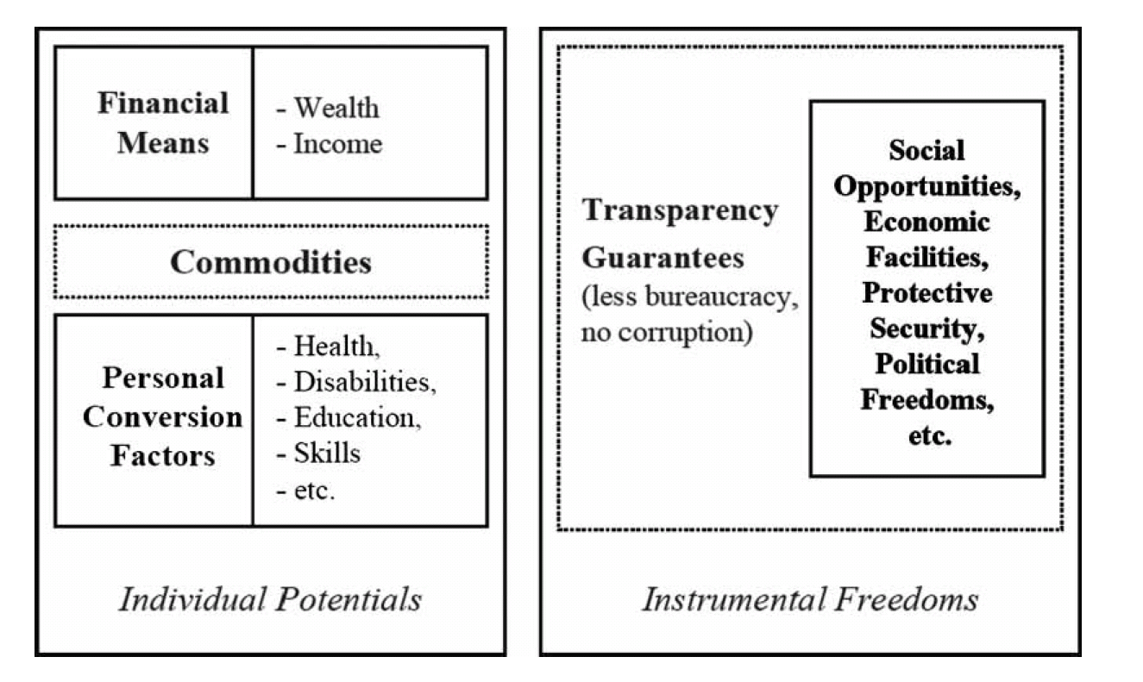
4 Concept and Operationalization –
Determinants AND Multidimensionality
Overview over “Main Determinants of Capabilities”
Source: Arndt & Volkert (2011)

Slide 8
4 Concept and Operationalization
Data Adequacy and Availability
Requirements
  Representativity for all people living in Germany
  allow
    multidimensional identification, in time
    multivariate analyses
  Strategy -> use existing data
Available Data
  EU-SILC
  EVS
  GSOEP
  other

Slide 9
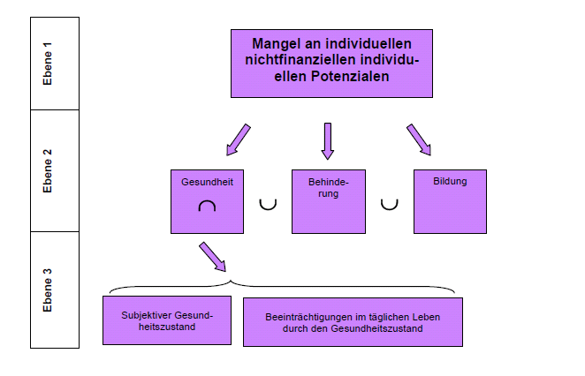
4 Aggregation of Indicators and Levels
Source: IAW (2006)

Slide 10
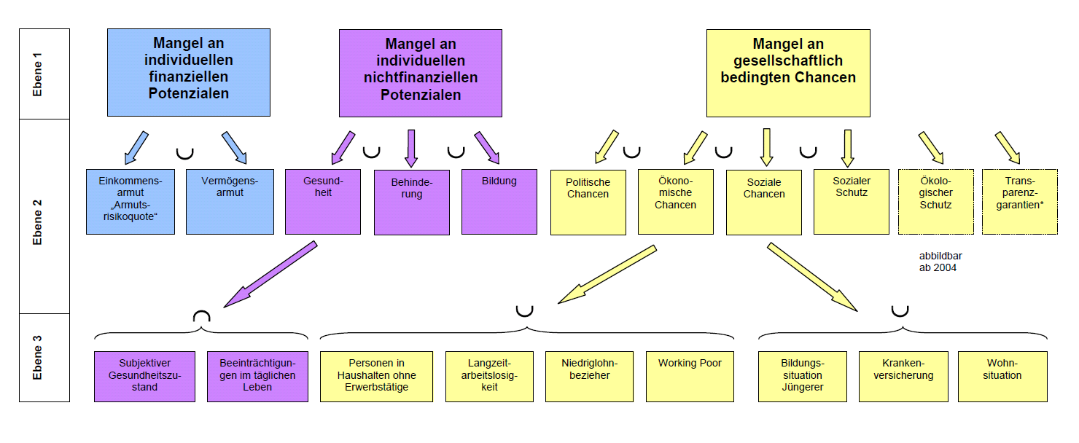
4 Aggregation of Indicators and Levels

Slide 11
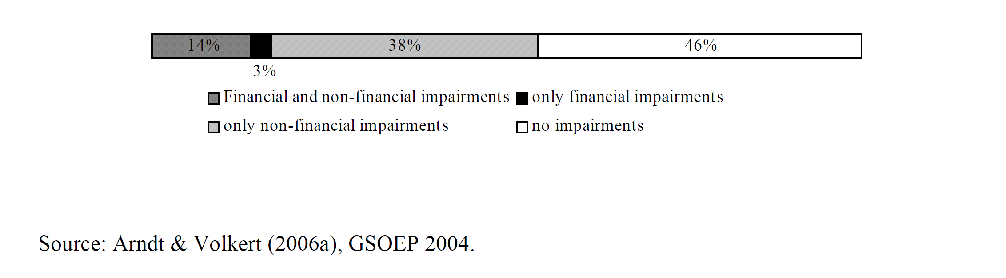
4 Examples
Determinants of Capabilities – the degree of multidimensionality
Financial and non-financial impairments of determinants of capabilities in Germany (2004)

Slide 12
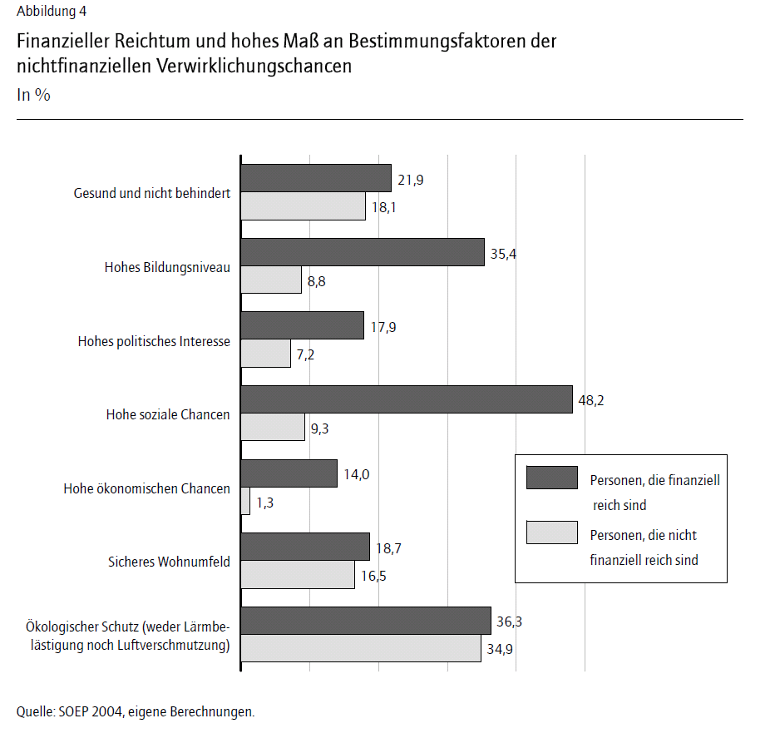
4 Examples
Dependencies
richness
indicators on the second level
household & indiviual perspective
Source: Arndt and Volkert (2006)

Slide 13
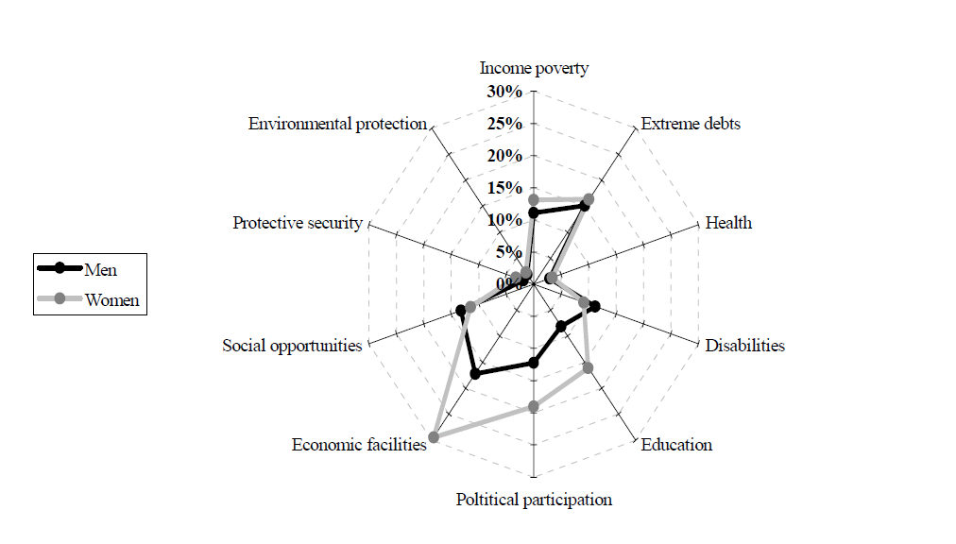
4 Examples
Gender aspects
Source: Arndt and Volkert (2007)

Slide 14
4 Examples
Income and Wealth

Slide 15
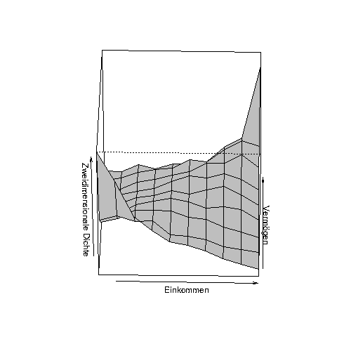
4 Examples
Income and Wealth

Slide 16
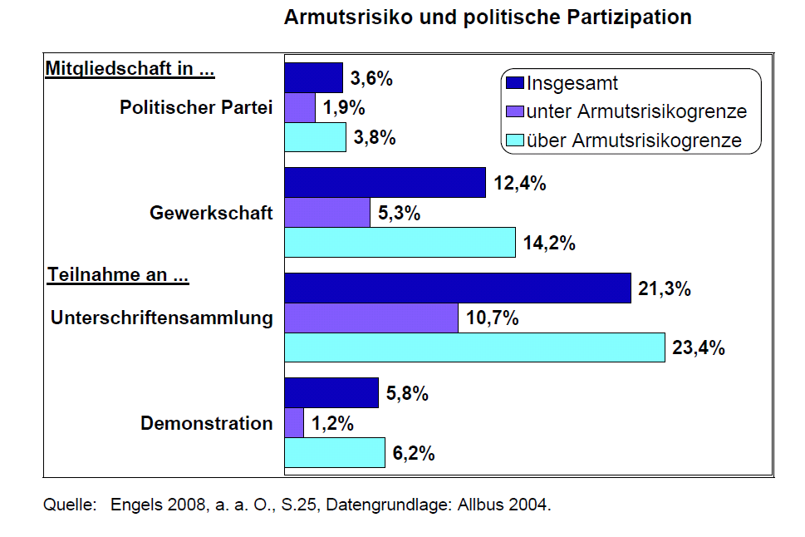
4 Examples
Determinants of Capabilities – dependency of drivers
Political participation and income poverty risk
Source: 3rd German Poverty & Wealth Report (2008)

Slide 17
5 Structure of the 3rd report (Summer 2008)
Analytical part
  relies on socio-economic studies, contributed by independent German researchers , comission on behalf of the German government
  highlight major findings regarding poverty, wealth, conditions of life and capabilities in Germany
  follows the system of main determinants of capabilities
Policy part
  also structured along the core determinants of capabilities
  written by the government
  shows how the government plans to or already has taken action

Slide 18
6 Structure of the 4rd report
(Summer 2012, forthcoming)
General part
  Development of Core Indicators
Determinants of low and high levels of “participation” in „crucial“ periods in life time
  Initial opportunities in the early years
  Opportunities on the labor market (younger adults)
  Opportunities and risks (middle adult years)
  Social participation of the elderly

Slide 19
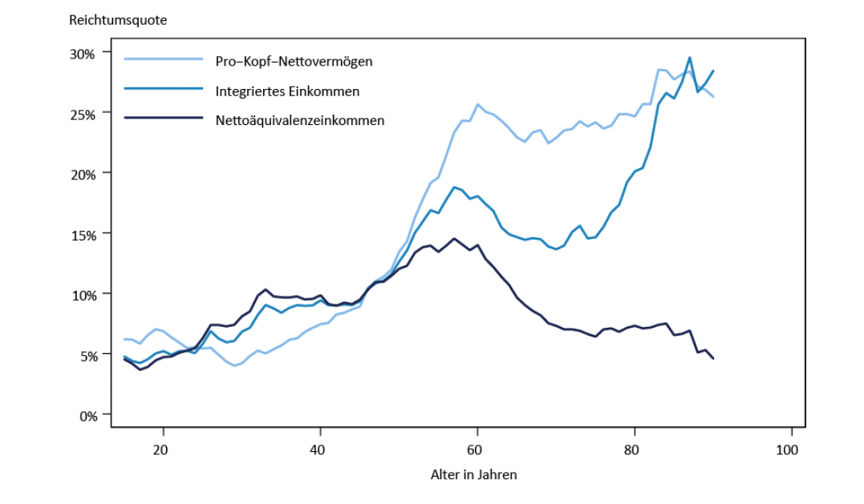
6 Examples
Richness (Income and Wealth) &
Lifetime Periods
Richness, head counts
Age
Source: IAW (2012, forthcoming)

Slide 20
Some of the cited Literature
Arndt, Christian und Jürgen Volkert (2011) The Capability Approach: A Framework for Official German Poverty and Wealth Reports, Journal of Human Development and Capabilities, Vol. 12 No. 3, 311-337.
Arndt, Christian, Martin Biewen, Bernhard Boockmann, Martin Rosenmann et al. (2012) Aktualisierung der Berichterstattung über die Verteilung von Einkommen und Vermögen in Deutschland für den 4. Armuts- und Reichtumsbericht der Bundesregierung. Gutachten für das Bundesministerium für Arbeit und Soziales. Tübingen.
Arndt, Christian, Rolf Kleimann, Martin Rosemann, Jochen Späth und Jürgen Volkert (2010) Möglichkeiten und Grenzen der Reichtumsberichterstattung. Bericht an das Bundesministerium für Arbeit und Soziales. IAW, Tübingen.
Arndt, Christian, Sabine Dann, Rolf Kleimann, Harald Strotmann und Jürgen Volkert (2006) Das Konzept der Verwirklichungschancen (A. Sen) – Empirische Operationalisierung im Rahmen der Armuts- und Reichtumsmessung – Machbarkeitsstudie. Bericht an das Bundesministerium für Arbeit und Soziales. IAW, Tübingen.
Arndt, Christian und Jürgen Volkert (2006) Amartya Sens Capability-Approach - ein neues Konzept der deutschen Armuts- und Reichtumsberichterstattung, Vierteljahreshefte zur Wirtschaftsforschung 75(1), S. 7-29.

